Slide 1
Digital Thinking and Innovation
Digital Generation

Slide 2
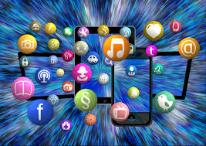
Introduction
This topic introduces the digital generation: the era of the digital natives

Slide 3
Learning Outcomes for the Lecture
At the end of this lecture you will be able to:
Understand the Digital Generation
Differentiate between the Millennials and the Gen Z
Highlight the characteristics of Gen Z
Discuss how Gen Z will shape the future

Slide 4
Content
Digital Generation
The Generation Z
Characteristics
Video
Generation Z: The Social Demise of the Digital Natives

Slide 5
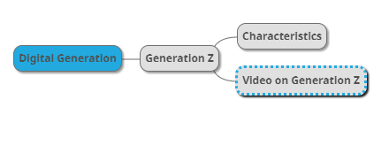
Mind Map

Slide 6
Learning Outcomes for the Lecture
At the end of this lecture you will be able to:
Understand the Digital Generation
Differentiate between the Millennials and the Gen Z
Highlight the characteristics of Gen Z
Discuss how Gen Z will shape the future

Slide 7
Digital Generation
Digital Generation: Generation Z
Those who are growing up constantly connected to the world around them through smartphones, tablets, and computers.
Because of this hyperconnectivity, this generation will learn, think, act and respond differently than the previous generations.

Slide 8
Learning Outcomes for the Lecture
At the end of this lecture you will be able to:
Understand the Digital Generation
Differentiate between the Millennials and the Gen Z
Highlight the characteristics of Gen Z
Discuss how Gen Z will shape the future

Slide 9
Research
Click on the link below to understand the different generation (Boomers, Gen X, Gen Y, and Gen Z )
https://offer.kasasa.com/exchange/articles/generations/gen-x-gen-y-gen-z

Slide 10
Digital Generation
The Millennials Vs. Gen Z
On the surface, Gen Z may seem similar to Millennials
How different can they be?
https://www.salesforce.com/blog/2017/10/how-millennials-and-gen-z-are-different.html
Similarity | Difference
Both: Are shaped by technology Have mostly lived life in a mobile-first world | Markedly different in how they: Shop Interact with brands View money

Slide 11
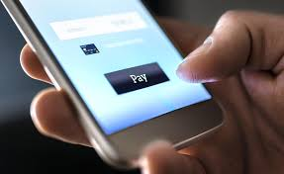
The Generation Z
Gen Z: A “throwback generation” — one that wants to work, save money, and not get stuck or trapped by credit (The Center for Generational Kinectics, State of Gen Z 2017 Study)
48% of Gen Z has a money or payment app on their phone right now.
https://thefinancialbrand.com/67175/digital-generation-z-millennials/
http://www.genhq.com/gen-z-2017

Slide 12

The Generation Z
More ad-averse
More willing compare other generations to engage with brands
Doesn’t find brand texts, notifications or mobile offers invasive
Spends more than an hour a day on their mobile device
Many are already thinking about retirement
Personal debt should be avoided at all costs
A marked shift from the Millennial mindset that “college debt is a part of life”

Slide 13
Learning Outcomes for the Lecture
At the end of this lecture you will be able to:
Understand the Digital Generation
Differentiate between the Millennials and the Gen Z
Highlight the characteristics of Gen Z
Discuss how Gen Z will shape the future

Slide 14
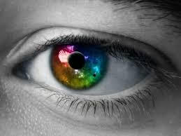



Characteristics
Insightful & Savvy
Responsible Self-Starters
Risk-Averse & Adaptable
Tech-Enabled

Slide 15
Insightful & Savvy
Information and “world knowledge” are vastly available
They know what they know, and they know what they don’t know
They can see through disingenuous motives of traditional marketing
They want to be served in a transparent and socially responsible way

Slide 16
Responsible Self-Starters
Driven, hard-working, and generally responsible
Clever and industrious — eager to put in the hard work to fulfill their dreams
Believe technology can be their catalyst
Generally understand the concept of making money work for them, both immediately today and down the road tomorrow
Want to help create jobs and contribute to a thriving, balanced global economy

Slide 17

Risk-Averse & Adaptable
Understand that everything can change in a minute
A sense of extreme pragmatism
Gen Z consumers cautiously weigh the practicality of their material purchases
Many have a savings-conscious mindset
Critically consider the value equation of any purchase
See technology advancing day by day, and know that something that exists today could be improved tomorrow

Slide 18
Tech-Enabled
Access to computers and smart phones at a very early age
“Digital Natives”, but still crave and value human contact
Have the adaptability to learn faster, and have a self-starter mentality that empowers them to figure things out on their own

Slide 19
Intermission
https://www.youtube.com/watch?v=VC8IakWSu-0&t=304s

Slide 20
Learning Outcomes for the Lecture
At the end of this lecture you will be able to:
Understand the Digital Generation
Differentiate between the Millennials and the Gen Z
Highlight the characteristics of Gen Z
Discuss how Gen Z will shape the future

Slide 21
Stereotype Negative Traits?
Have a short attention span (eight seconds)
Able to communicate effectively and concisely
Multitaskers – increases stress level
Can thrive in a “chaotic” environment, increase productivity, save money, and time.
Addicted to technology and can’t handle face-to-face interactions
Willing to be technology mentors to others in the office

Slide 22
Stereotype Negative Traits?
Expect too much from the brands and companies they interact with
Have strong beliefs (ethically)
Tend to job-hop and ghost employers
Employers will have to rise to the challenge
Competitive benefits
Great company culture
Opportunities for career growth

Slide 23

Group Discussion
Watch and discuss the content of the video:
Generation Z: The Social Demise of the Digital Natives https://www.youtube.com/watch?v=a7ff98PL2X4

Slide 24
Summary
Digital Generation
The Millennials vs. Generation Z
Characteristics of Generation Z

Slide 25
Questions and Answer
Q & A

Slide 26

Next Lecture
Agile and Digital Thinking

